Slide 1
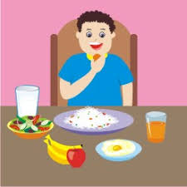
FOOD AND HEALTH

Slide 2
FOOD GROUPS
We eat a variety of food. The food we eat contain five main components. Our body needs all these components to remain healthy.

Slide 3
